Slide 1




Malicious URL Detection using
Machine Learning
By:
Aman Gupta(Rollno. 25)
Dev Jindani(Roll no. 46)
Manu Khandelwal(Roll no.50)

Slide 2


A malicious URL is a link created with the purpose of promoting scams, attacks and frauds. By clicking on an infected URL, you can download a malware or a Trojan that can take your devices, or you can be persuaded to provide sensitive information on a fake website.
On an average malicious websites cause losses of billions of dollars every year.
It is imperative to detect and act on such threats in a timely manner.
Introduction

Slide 3
Problem Definition
Typically, malicious links are used to lure a victim into clicking through to a payload that is hosted on third-party sites rather than the malicious content being directly available from the social media platform. One-click exploits such as those used for account takeover could easily be distributed via social media and, when clicked, could exploit the victim in terms of profile takeover or misguiding users for fake advertisements.

Slide 4
Future Scope
IN THIS PROJECT WE DESIRE TO DETECT MALICIOUS LINKS AND ITS ORIGIN SIGNATURE (FIRST UPLOADED PERSON-PROFILE URL, NAME, EMAIL, NUMBER ETC.) ON A REAL TIME BASIS AND PROVIDE ADVISORY REPORT TO THE PUBLIC AND CORRESPONDING AGENCIES ABOUT THOSE LINKS SOURCE CREDIBILITY.
IN THIS PROJECT WE WILL NOT ONLY DETECT THE LINKS WHICH ARE ALREADY BLACK LISTED BUT WILL ALSO DETECT NEWLY GENERATED LINK BY USING APPLICATIONS OF MACHINE LEARNING AND ARTIFICIAL INTELLIGENCE.

Slide 5
Implementation
This section discusses the overall implementation of building the anti-phishing software recommendation system. It includes a detailed description of all the tasks carried out in this research to successfully recommend the software to the user.
A URL is somewhat a protocol that is used to indicate the location of data on a network. The URL is composed of the subdomain, primary domain, top-level domain (TLD), and path domain. In this study, the subdomain, primary domain, and TLD are collectively referred to as the domain.

Slide 6
Implementation
The protocol refers to a communication protocol for exchanging information between information devices; e.g., HTTP, FTP, HTTPS, etc. Protocols are of various types and are used in accordance with the desired communication method.
D The dataset developed by us consists of phishing and non-phishing URLs this data is first processed i.e. important features finalized by us are extracted from these URLs to get the final dataset.

Slide 7
Implementation
The phishing URLs for our dataset is taken from PhishTank while legitimate URLs are taken randomly from the day to day websites visited by the users. The total data set comprised of 3000 urls (legitimate + illegitimate). Out of which 2000URLs were used for training and 1000 were used for testing.

Slide 8
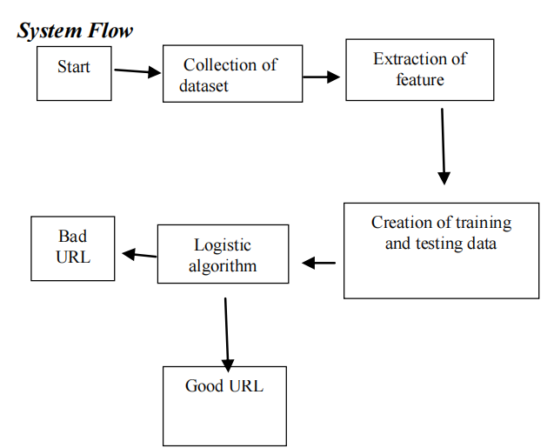
A general processing framework for Malicious URL Detection using Machine Learning

Slide 9
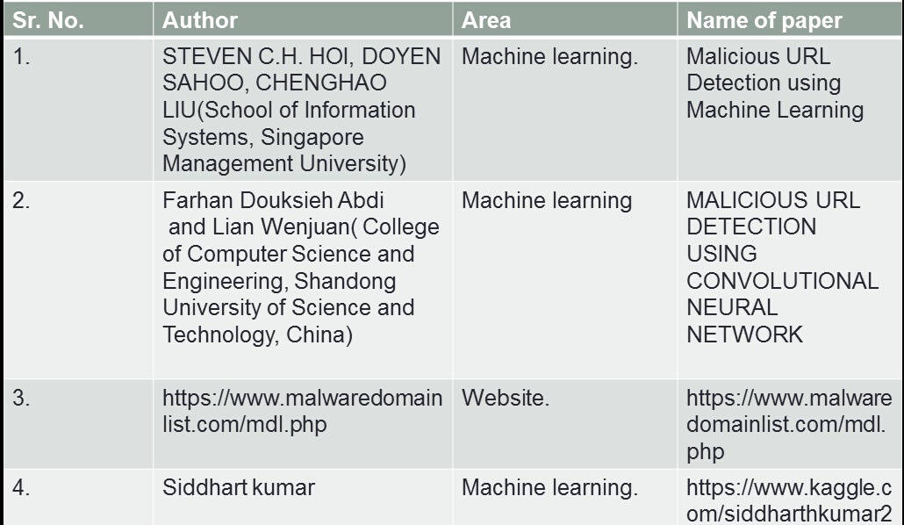
Literature Survey

Slide 10
Malicious URL detection plays a critical role for many cybersecurity applications, and clearly machine learning approaches are a promising direction.
Result & Conclusion
We are planning to conduct a compre-hensive and systematic survey on Malicious URL Detection using machine learning techniques.
In particular, we are planning to offer a systematic formulation of Malicious URL detection from a machine learning perspective.

Slide 11
Thank You

